Slide 1


MATSEC Examinations
2025- onwards
Prospective
year 9, 10 and 11 students

Slide 2
Agenda
Important Terms
Controlled Assessment
SBA
SBA, MYSCHOOL and SSC &P
MATSEC assessment
Important links
Choice of Level
Grading System
MATSEC Result
VET Media Literacy
Supplementary Session

Slide 3
Important Terms
Continuous/ School Based Assessment
Controlled Assessment
Set by the school teacher
Set by MATSEC
An end of course assessment
Relevant to SEC syllabus

Slide 4
MATSEC Assessment
Assessment
Part 1
Part 2
School Based assessment
Controlled assessment
II
30%
70%
SCHOOL CANDITATE
NON- VOCATIONAL SUBJECTS

Slide 5
MATSEC Assessment
Assessment
Part 1
Part 2
Controlled assessment
I
Controlled assessment
II
Centrally set and marked
Centrally set and marked
30%
70%
PRIVATE CANDITATE
NON- VOCATIONAL SUBJECTS

Slide 6
Choice of Level for Controlled assessments
Candidates must register with MATSEC in the beginning of their Year 11 (Form 5) during the registration period published by MATSEC.
During the registration period, the candidate must indicate the choice of paper:
Level 1-2 or
Level 2-3

Slide 7
Choice of Level for Controlled assessments
During the registration period, the candidate must indicate the choice of paper:
Level 1-2
Level 2-3
Level 3.3*
Mathematics only

Slide 8
MATHEMATICS
Syllabi of each level are different.
You will be informed which level your child will be following:
Level 1-2
Level 2-3
Level 3- 3*

Slide 9
School Based Assessment
SBA can be pegged at either of two categories:
A coursework at MQF level categories 1-2
A coursework at MQF level categories 1-2-3 .
The mark for assignments at level categories 1-2 presented for a qualification at level categories 2-3 is to be recalculated to 60% of the original mark. The mark stands in all other cases.
The teacher will indicate to the students which task is for SBA. Some teachers may use all the scholastic tasks as SBA.

Slide 10
School Based Assessment Grading
 | For their Year 9 | For their Year 10 | For their Year 11
Total of 30% | 10% | 10% | 10%
The three SBA marks submitted by the school will be multiplied by 0.3 to produce the candidate’s final SBA score (out of 30).

Slide 11
SBA School Candidates applying for Level 2-3
For the 2026 session
Minimum of 12 out of 30 in the SBA
For the 2027 session
Minimum of 14 out of 30 in the SBA
To be eligible for Level 3, school candidates must meet specific requirements in both the School-Based Assessment (SBA) (Paper I) and the controlled assessment (Paper II).

Slide 12
SBA School Candidates applying for Level 1-2
For the 2026 session
Minimum of 12 out of 30 in the SBA
For the 2027 session
Minimum of 14 out of 30 in the SBA
To be eligible for Level 3, school candidates must meet specific requirements in both the School-Based Assessment (SBA) (Paper I) and the controlled assessment (Paper II).

Slide 13
SBA Mathematics School Candidates applying for Level 3-3*
For the 2026 session
Minimum of 12 out of 30 in the SBA
For the 2027 session
Minimum of 14 out of 30 in the SBA
To be eligible for Level 3, school candidates must meet specific requirements in both the School-Based Assessment (SBA) (Paper I) and the controlled assessment (Paper II).

Slide 14
Please note that meeting the SBA threshold alone does not guarantee a Level 3 qualification, for candidates sitting Level 2-3 or Level 3-3* , or Level 2 for candidates sitting level 1-2, as the final level awarded depends on overall performance in both the SBA and the controlled assessment. Higher SBA scores contribute more significantly to the candidate’s potential to achieve that level.
Candidates who score below 12 in 2026 or 14 in 2027 in the SBA will not be awarded a Level 3/2.

Slide 15
School Based Assessment GraDING
SBA will remain for the students for 5 consecutive years.
Students who miss, for valid reason only, most of a scholastic year are allowed to sit for the private candidate paper. However, the students has no option but to follow SBAs tasks during school hours and complete all projects and work-related.
 | For their Year 9 | For their Year 10 | For their Year 11
Total of 30% | 10% | 10% | 10%

Slide 16
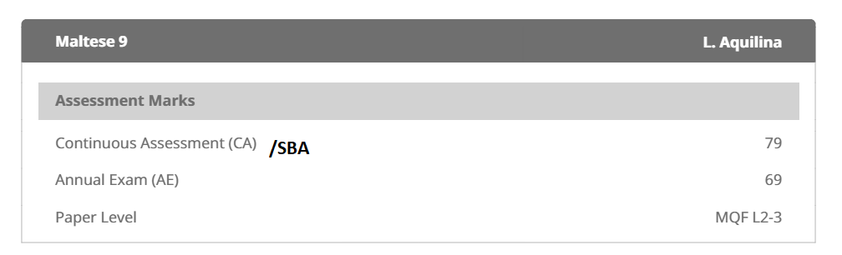
SBA and MYSCHOOL
The SBA mark is the mark that will be reported to the parents through MYSCHOOL in
January (mark form October to February)
July (from October to June).

Slide 17
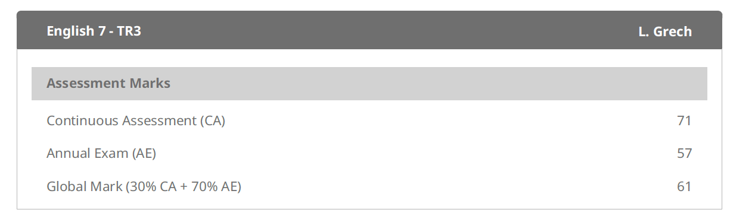
For year 8
The percentage of how the global mark is calculated according to the subject.

Slide 18
Controlled Paper II grading
Highest level of Achievement
Candidates sitting for:
Level 1-2 may be awarded grades 6 – 8
Level 2-3 may be awarded grades 1- 7.
The results of candidates who do not obtain at least Grade 7/8 shall remain unclassified and shall be denoted as U
1
2
3
4
5
6
7
8
Lowest level of Achievement

Slide 19
Controlled Paper II grading
Highest level of Achievement
1
2
3
4
5
6
7
8
MATHEMATICS ONLY
Level 1-2 -Grades 6, 7 or 8 or Unclassified (U).
Level 2-3 - Grades 4, 5, 6 or 7 or Unclassified (U).
Level 3-3* -Grades 1, 2, 3, 4, or 5 or Unclassified (U).
Lowest level of Achievement

Slide 20
Grading System- Overall Level
Lowest level of Achievement
Combining the result of SBA and Controlled assessment according to
30% SBA : 70% Controlled.
To obtain level 3, the student needs to satisfy the requirements of the examiners in both SBA and Controlled.
MQF level 3 is the highest level- and the only level accepted for Post- Secondary institutions.
1
2
3
Highest level of Achievement

Slide 21
MATSEC REPORT
SUBJECT | PAPER I | PAPER II | LEVEL
 | [0-30] | [1 – 8] | [1 - 2 – 3]
Ex: Chemistry | 27 | 2 | 3
Ex: English | 26 | 3 | 3
For private candidates, only the Grade and the Level will be reported, and the term PC (Private Candidate) will be shown under the Paper I column.
Marks for Paper 1 Controlled for Private candidates will remain valid for 1 year.

Slide 22
Supplementary Session
Only the following subjects are available for the supplementary session:
a. Il-Malti
b. English Language
c. Mathematics
d. One science subject -may sit for only one examination in either Biology or Chemistry or Physics, provided that they did not already obtain a Level 3 in any of these three subjects in the Main session.
In the Supplementary Session, only levels 2-3 shall be offered for Paper II.

Slide 23
VET MEDIA Literacy – SEC 2025 and 2026
Prospective year 11 and year 10 students
Consist of three Units: one Unit for each of Years 9, 10 and 11;
Students may qualify for Grades 1, 2, 3, 4, 5, 6, 7 or 8. The results of candidates who do not obtain at least Grade 8 shall remain unclassified and shall be denoted as U.
Assessment of each unit
Coursework
Set by school teacher but moderated by MATSEC
Controlled
Set by MATSEC
Two per unit
One per unit

Slide 24
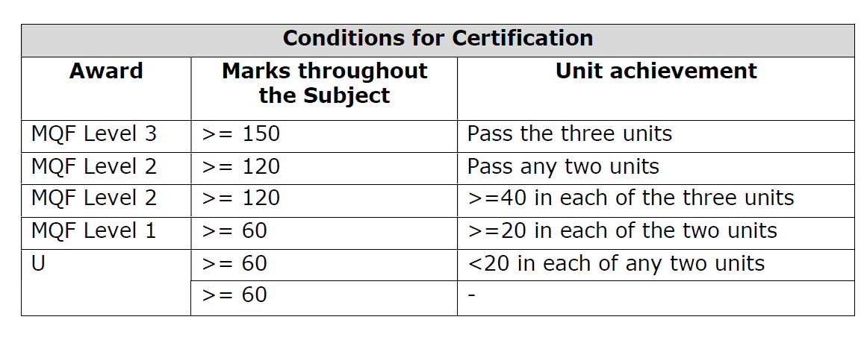
VET MEDIA Literacy – SEC 2025 and 2026
Refer to the Handbooks given at the beginning of the scholastic year for more details

Slide 25
VET MEDIA Literacy – SEC 2027
Assessment
SBA
30%
30%
Set by school teacher
Set by school teacher but moderated by MATSEC
Controlled
40%
Set by MATSEC
Per unit
Coursework
Per unit
Only in year 11
Prospective year 9 students
Candidates shall not be required to choose a level as Paper 11 will be set at all levels.

Slide 26
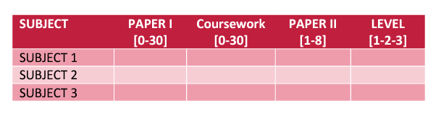
VET MEDIA Literacy – SEC 2027
The results and certificates for vocational subjects will report each component and the overall Level as shown below:

Slide 27
Important links
LOF syllabi- Procedures: https://www.um.edu.mt/__data/assets/pdf_file/0005/438611/LOFSyllabusPanel2021.pdf
Marking Schemes:https://www.um.edu.mt/matsec/examinationpapers/markingschemes
Past Examination Papers :https://www.um.edu.mt/matsec/examinationpapers/past
Sample Examination Papers: https://www.um.edu.mt/matsec/examinationpapers/samplepapers
Syllabi:https://www.um.edu.mt/matsec/syllabi
Guidelines: https://www.um.edu.mt/matsec/guidelines-policies/
Regulations: https://www.um.edu.mt/matsec/regulations/

Slide 28
Thank you
Details in this presentation are subject to change

